Slide 1

INSPECTRONICS 2.0
TECtronics
Speakers:
Binayak Bishnu
K N Uma
Ishani Mishra
Coordinator:
Akriti Dalal

Slide 2



Slide 3
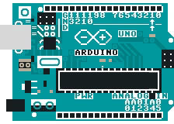
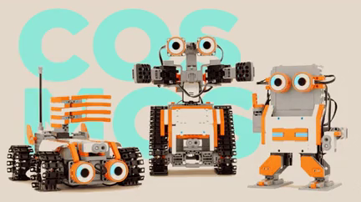
What we will cover today?
Introduction to the world of Electronics
Basics of Arduino
A few blocks of code
Hands-on project on TinkerCAD
Notes:
abcd

Slide 4

Woah! Let us not directly jump into the technical part. We can start with something fun.

Slide 5

Before joining VIT
After joining VIT

Slide 6


Slide 7

But we have got you!!

Slide 8


Slide 9


Slide 10

// A Hello from BINOD TEC Family
#include <iostream>
int main()
{
std::cout << "Hi Guys !! : ) “ ;
return 0 ;
}

Slide 11
A few things about VIT

Slide 12
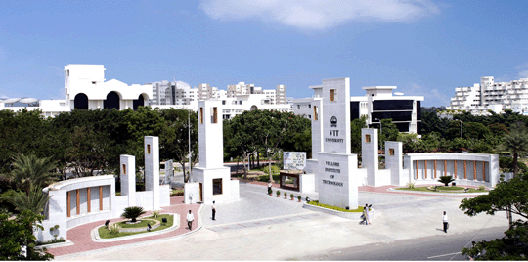
Main gate of VIT, Vellore

Slide 13

LAKE
Quick question: Can we go to the lake?

Slide 14
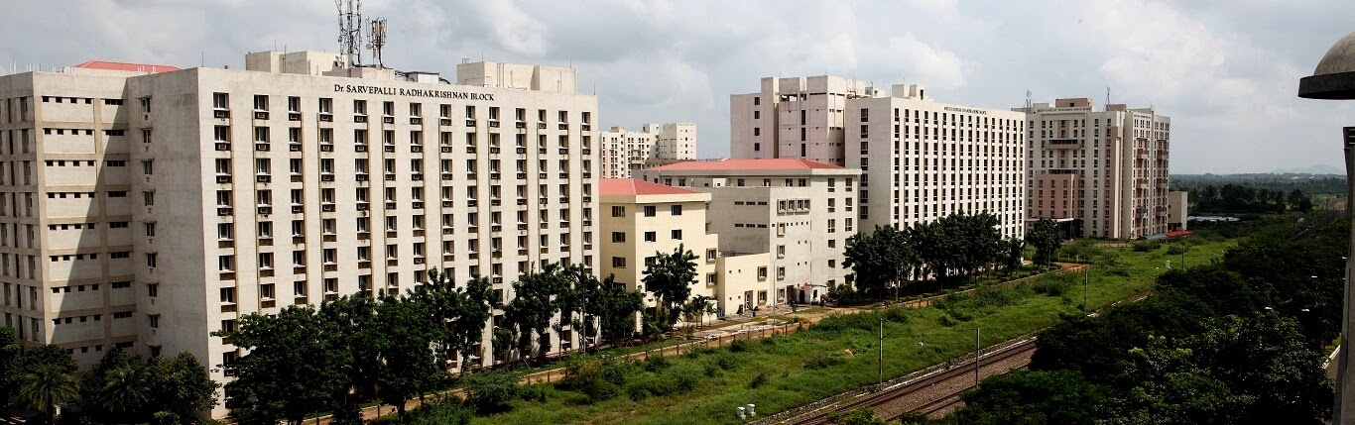
HOSTEL VIEW
Can you guys guess how many mens hostel blocks are there?

Slide 15


SJT View

Slide 16

TT View

Slide 17


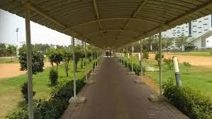
Walking paths

Slide 18

Fun task : You can turn your camera on and answer the following questions.
Introduce yourself
Where are you from?
What is your stream?
Interested in which domain of engineering?
https://campustour.vit.ac.in/tour.html

Slide 19

Clubs and chapters

Slide 20

Which one should I join?

Slide 21









ACHIEVEMENTS
Notes:
Our students are placed and have interned at companies like Samsung, Microsoft, Blackrock, Bajaj, Shell, JP Morgan, Bain & Company, Deloitte. They have bagged some of the highest on campus packages and won national and international hacks like Smart India hackathon and Pennapps.

Slide 22

Placements confirmed??

Slide 23

Into the electronics world!

Slide 24
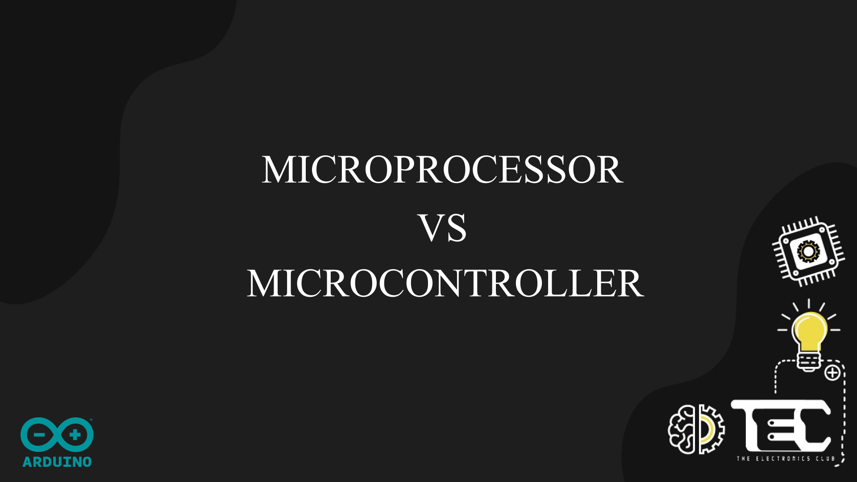
Notes:
To begin with, before moving onto what’s arduino and how it works let’s look into these two.

Slide 25
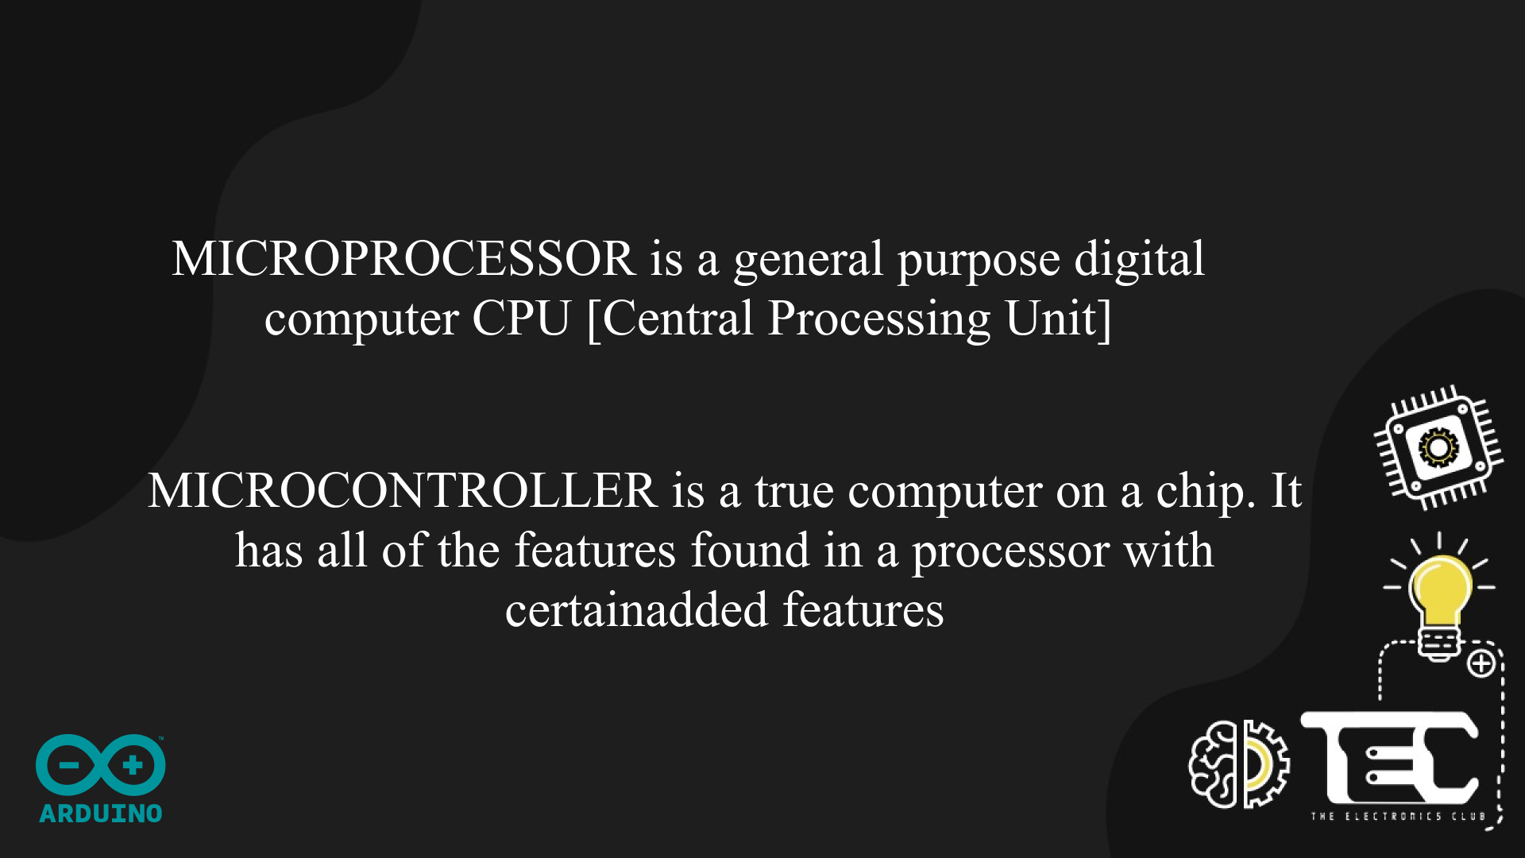
Notes:
The processor is the CPU in a computer where all the arithmetic, logic operations are processed. It is basically responsible for all the activities that happen internally within the system.
On the other hand, the microcontroller is an actual computer on a chip/board. It consists of the processor with added features like the RAM, ROM, ports etc.
In real world, the most known microprocessors are the ones from Intel, like the i3, i5 processors and so on
A few examples of microcontrollers are the Arduino and the Raspberry Pi.

Slide 26
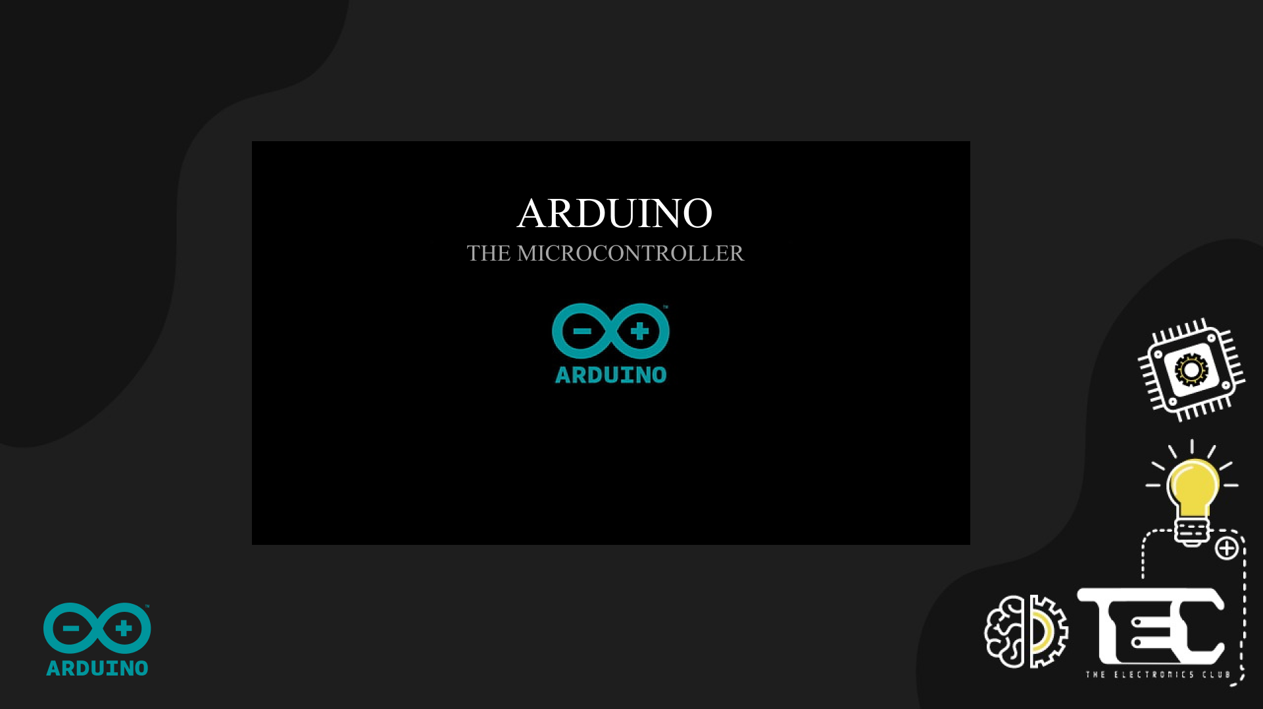

Slide 27
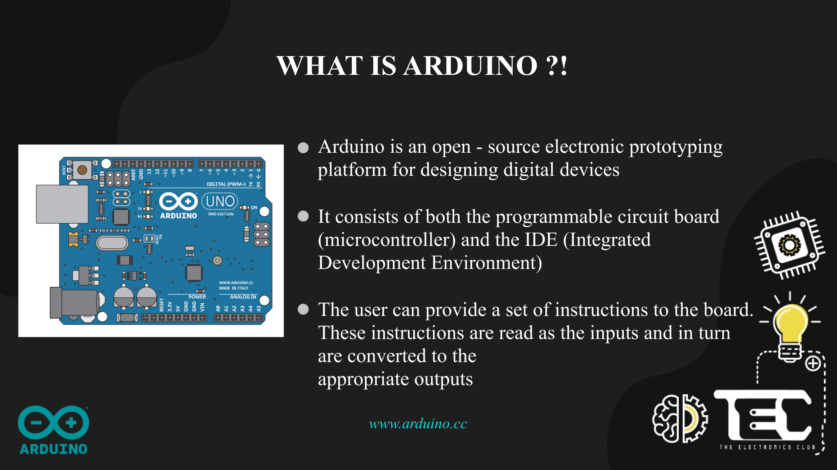

Slide 28


Slide 29
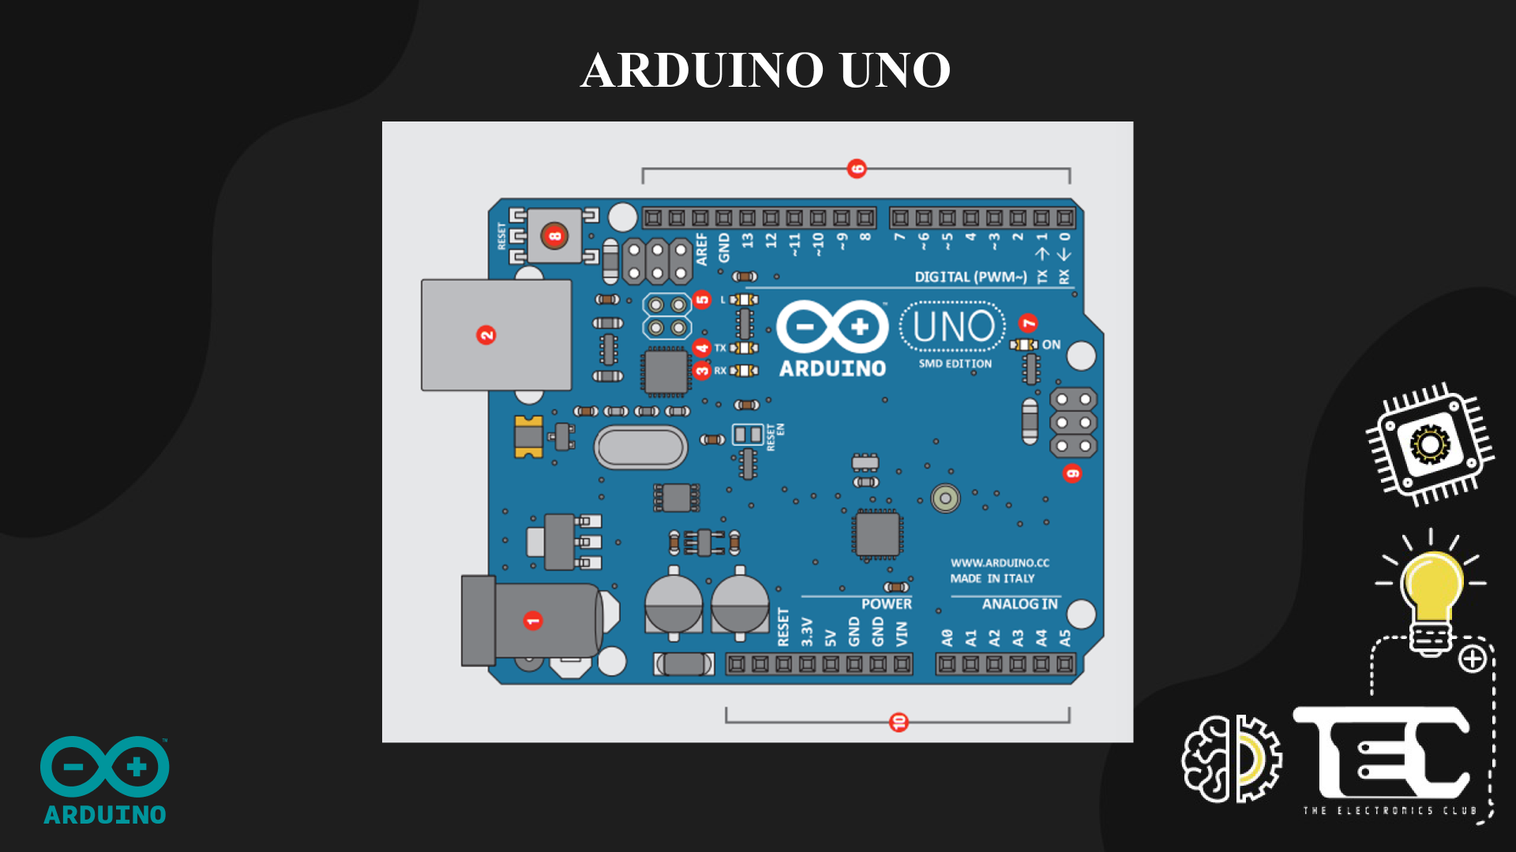
Notes:
Power In (Barrel Jack): Can be used with either a 9V or 12V wall-wart or battery
Power In (USB Port): Provides power and communicates with your board when plugged into your computer via USB.
LED (RX: Receiving): Lights up when the Arduino is receiving data (such as when being programmed).
LED (TX: Transmitting): Lights up when your Arduino is transmitting data (such as when running a program).
LED (Pin 13: Troubleshooting): LED is incorporated into your sketch to show if your program is running properly.
Pins (ARef, Ground, Digital, Rx, Tx): Used for inputs, outputs, power, and ground.
LED (Indicates Arduino is ON): Simple power indicator LED.
Reset button: Used to manually reset Arduino, which makes code restart.
ICSP Pins: For “in-circuit serial programming,” used if you want to bypass the bootloader.
Pins (Analog In, Power In, Ground, Power Out, Reset): Used for inputs, outputs, power, and ground.

Slide 30
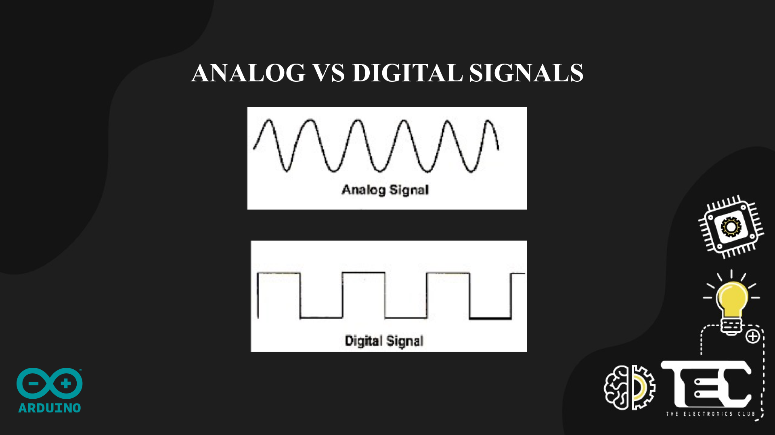
Notes:
An analog signal is a signal that can have a huge range of values. These values are continuous, like a sine wave.
If you’re using a microcontroller that has a “logic level” of 5V, it has a base voltage of 0 (ground) and a maximum voltage of 5V. With this logic level, an analog signal can vary anywhere between these two levels.
Most things we deal with in the real world are analog. Consider a light sensor that is used to measure the intensity of sunlight. When configured in a “voltage divider circuit” (more on this later), the amount of sunlight that shines on the light sensor will change the voltage across the light resistor. No light might correspond to a 0V signal. Partial shade might correspond to a 2.5 V signal, and full light might correspond to a 5V signal. And there are many many values in between. It’s a CONTINUOUS SIGNAL.
Digital signals are different. They have one of two values – either HIGH or LOW. The way we often seen this represented is as a 1 or a 0. 1 representing HIGH or ON, and 0 representing LOW or OFF. So if we’re talking about the same 5V microcontroller that we were before, when we get a voltage close to 5, it corresponds to a 1, and when we get a voltage close to 0 it corresponds to a 0. An example in real life is just a simple light switch. When we close the switch, electricity from the battery will flow through and turn the light bulb on. A microcontroller would measure that as a 1 because it’s seeing the full voltage. If the switch is open it would register that as a 0.

Slide 31
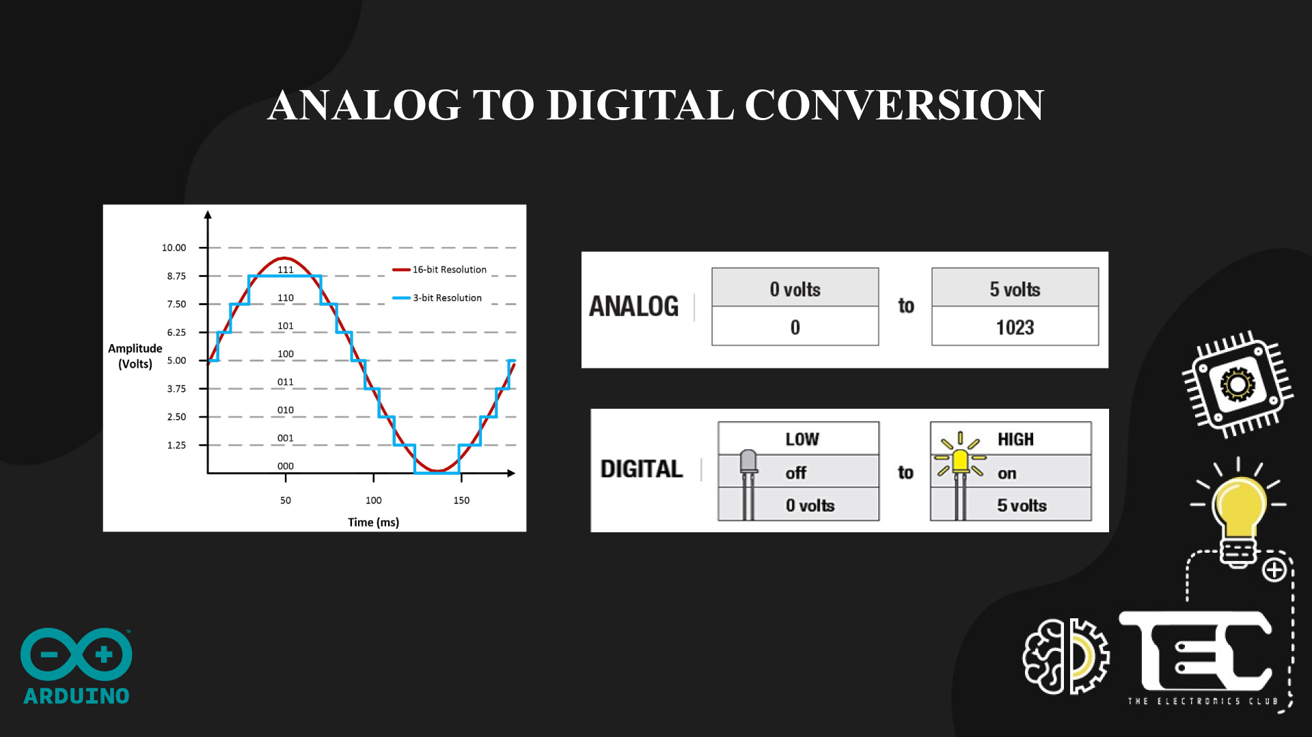
Notes:
Since most everything in the world is analog, how do we convert between the two? How do we take an analog signal and convert it to a digital signal? That’s done with analog-to-digital converters.
Let’s say we have that analog signal from the light sensor coming into our system, which ranges from 0V – 5V. So now we need to convert that to a digital signal because that’s what our Arduino needs in order to process it. What our digital signal looks like is going to depend on the resolution of the analog to digital converter (ADC) in our system.
Basically our system’s resolution is based on the number of bits. If we have a 10 bit ADC, that’s going to be 2^10 bits because 2 is the number of options we have (0 or 1). That equals 1,024. So a 10-bit system is going to have 1024 bits of resolution. Generally we see 0 to 1023 because 0 registers as 0V. This is really important because when we use the “serial monitor” in Arduino to read the voltage from the analog input pins, we’ll read values between 0 and 1,023. So keep this in the back of your head as we move forward.
So - a 10 bit system will break our analog signal into 10 different horizontal steps. As the figure on the slide shows, a 3-bit system will break the analog signal into 3 bits, which we can easily see. With a 16-bit system, it’s hard to see the different steps, and the signal looks a whole lot smoother.
Arduino translates an analog input voltage into a number that ranges from 0 - 1,023.
Digital voltages are translated into a number that ranges from 0 – 255.

Slide 32
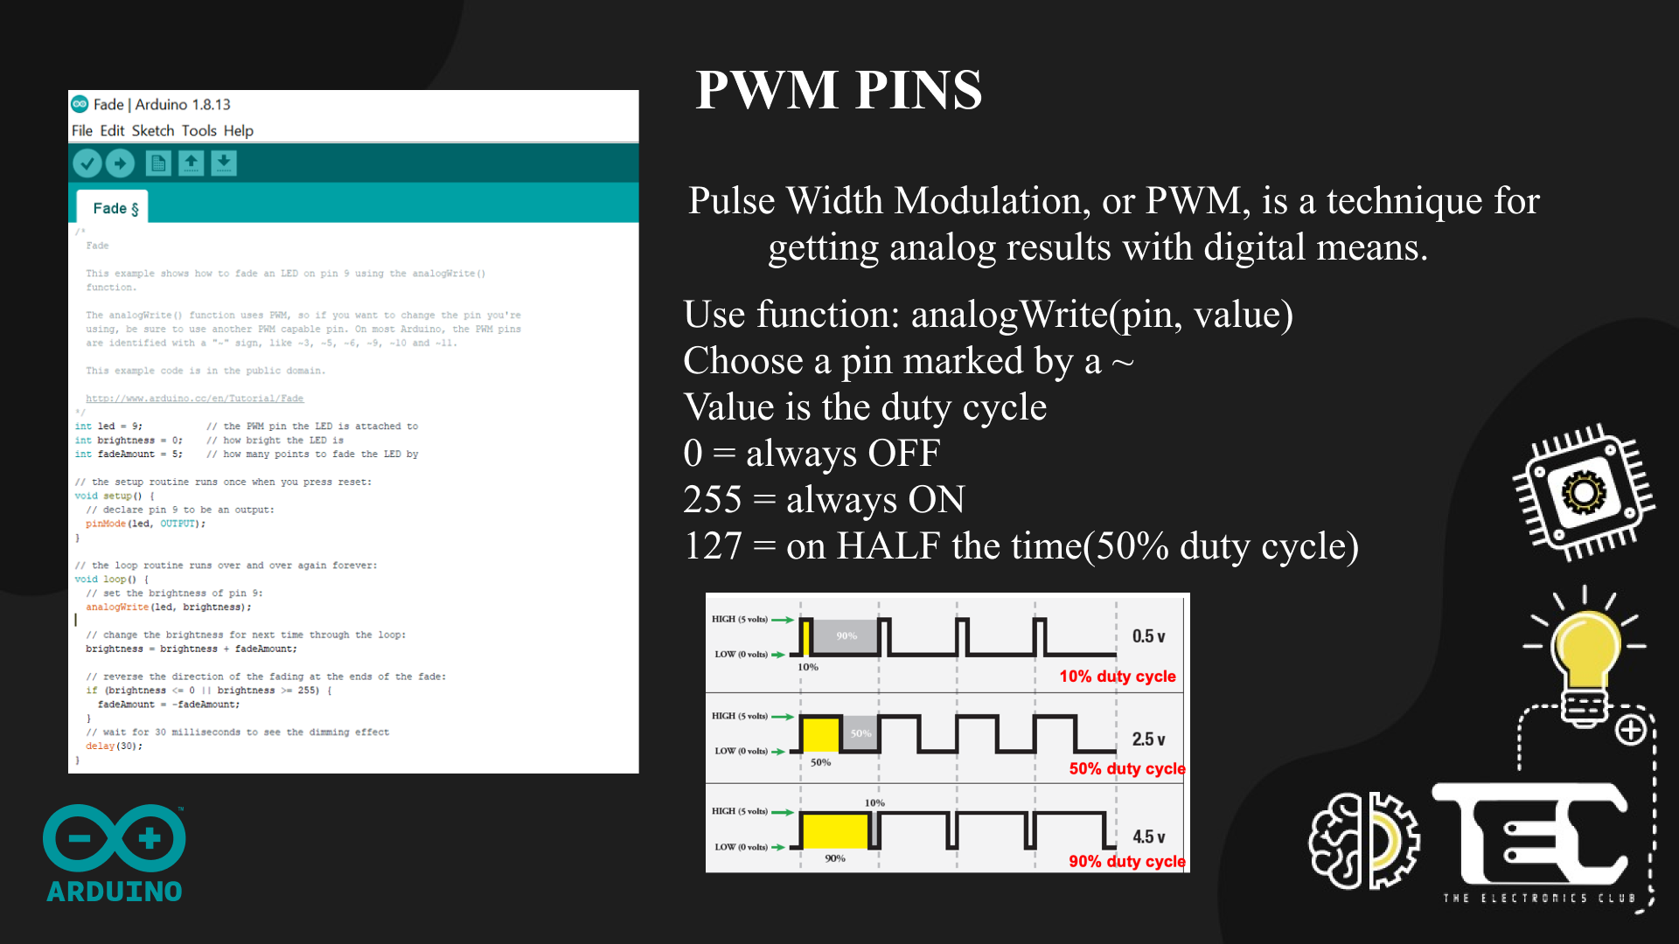
Notes:
So back to our issue with wanting to convert digital to analog. In this case we want to use the digital signal from our Arduino to change the brightness of an LED. So, we need to be output some varying voltage level. But our Arduino isn’t built for that.
We employ a trick called pulse width modulation (PWM). Because the Arduino is so fast, it can blink a pin on and off almost 1,000 times per second. Certain Arduino pins (those that can do PWM, indicated with a ~ next to them) go one step further by varying the amount of time the blinking pin spends HIGH vs. LOW. If it spends most of its time HIGH, a LED connected to that pin will appear bright. If it spends most of its time on LOW, the LED will look dim. Because the pin is blinking much faster than your eye can detect, the Arduino creates the illusion of a true analog output.
We use the function analogWrite() to do PWM. The first argument is the pin, and the second is the duty cycle

Slide 33
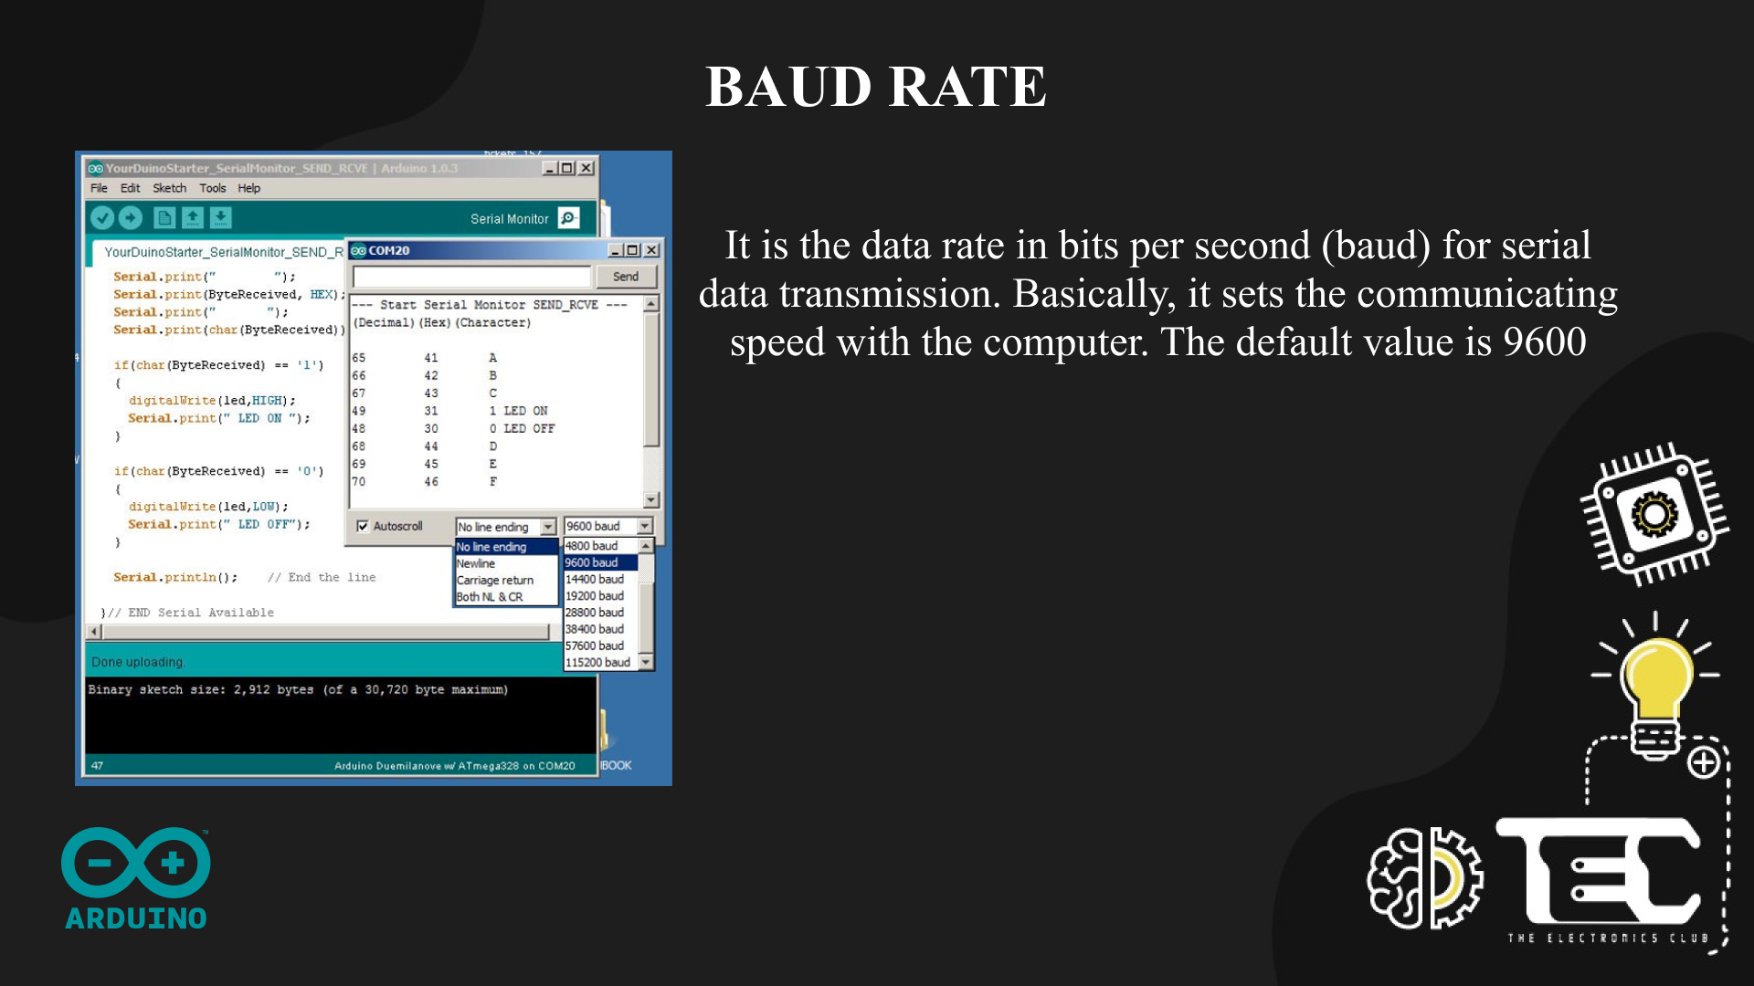
Notes:
You’ll be able to get a better understanding of it during the hands - on session

Slide 34
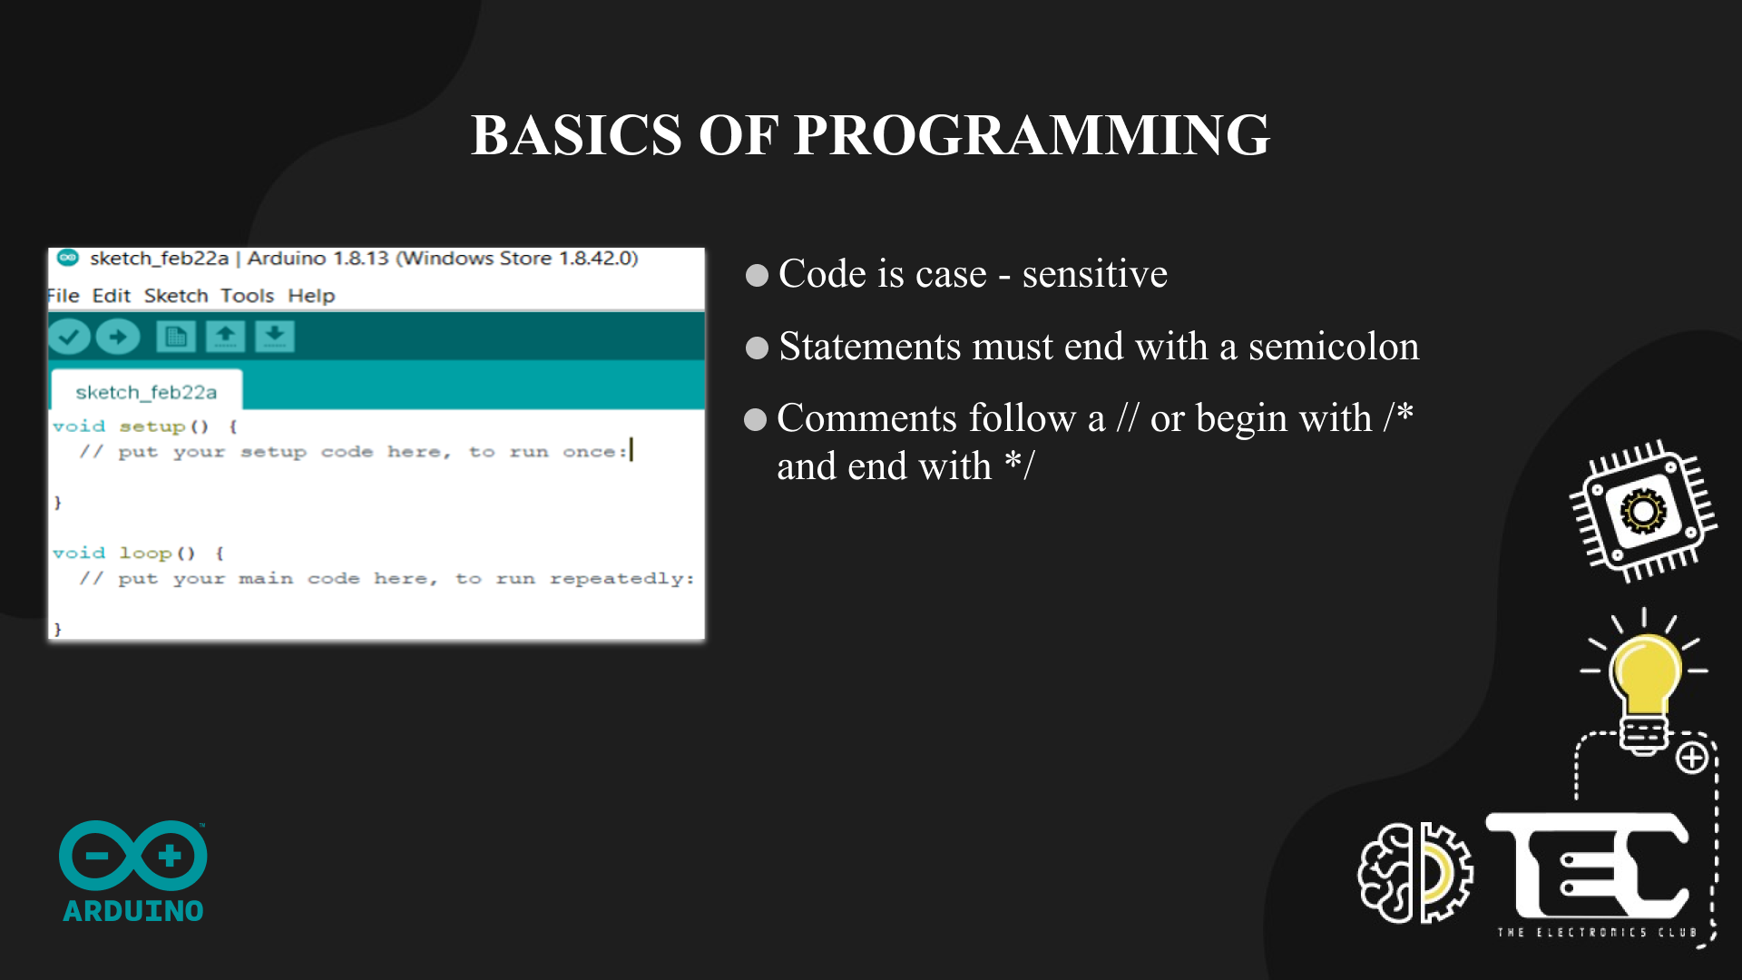

Slide 35
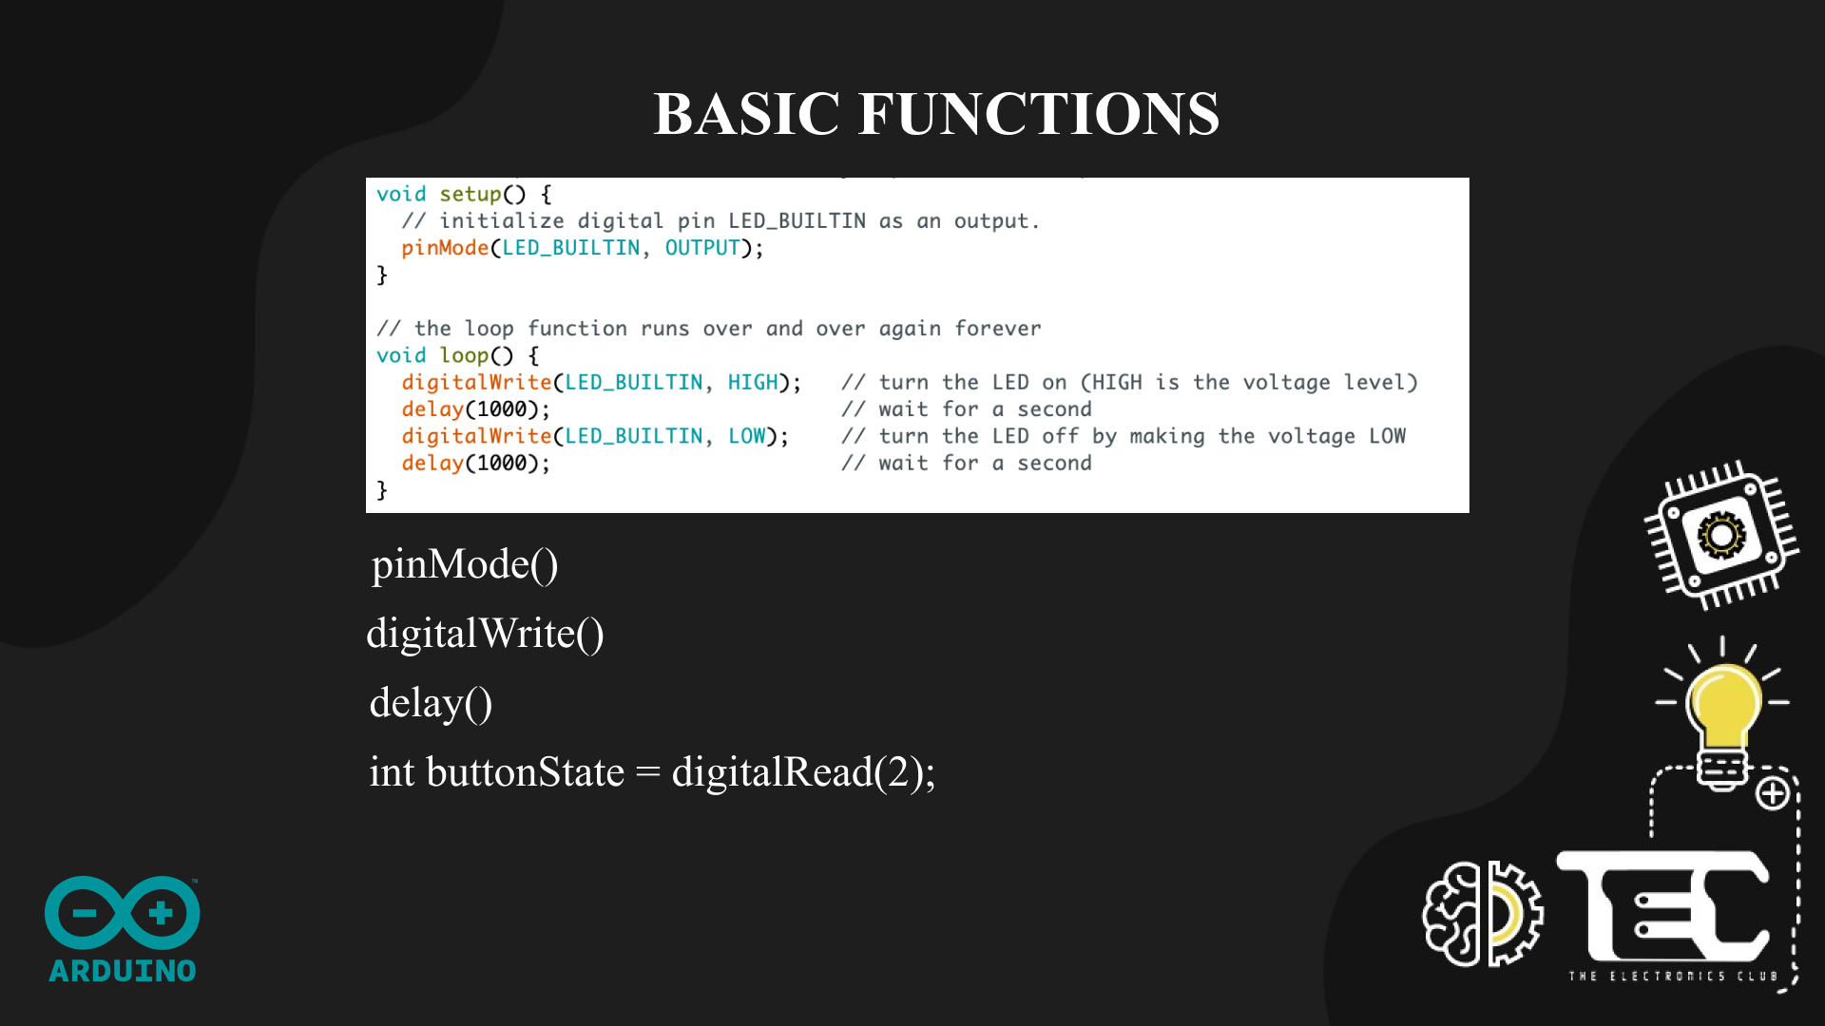
Notes:
With this we’ll be moving on to the hands - on session where Binayak will be taking over

Slide 36
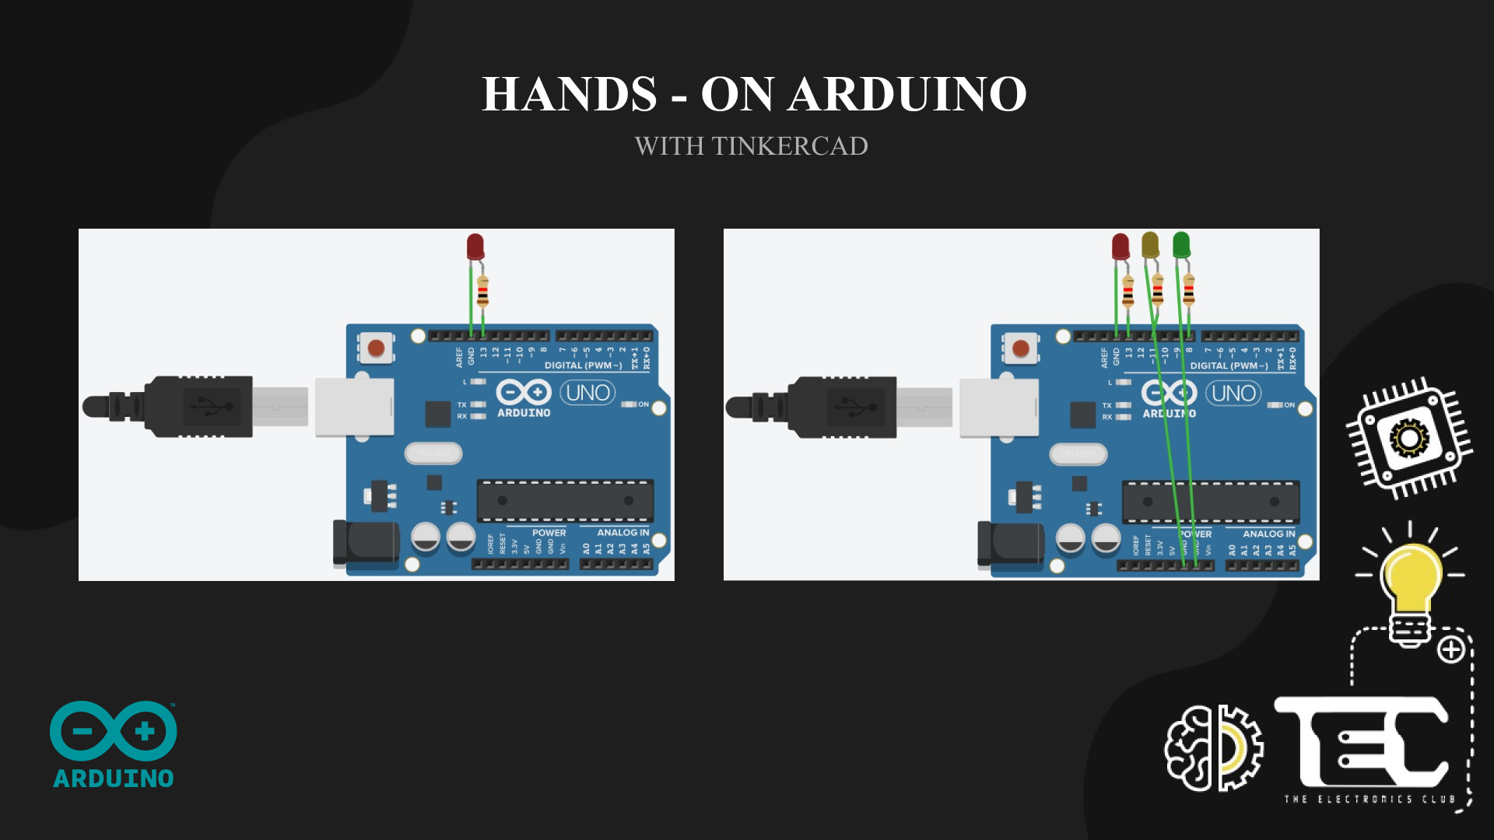

Slide 37


Slide 38
Samiksa M - BLACKROCK
Krishn Kumar – Shell
Maulishri Bhandari - JP Morgan Chase and Co.
Mayukh Ghosh- Microsoft
Sayak Banerjee - Bajaj Finance
Aditi Choudhary – Nutanix
Keshav Sharma - Capgemini and Schneider Electric
Ishita Kabra - Dyte

Slide 39
Prajna- Runner up - The climate change-makers challenge
Pranav Singh - Second runner up - IWD Hackathon
Khushi Singh, Shaurya Chandra - Winners - Techkriti 2021 by IITK (ECDC embedded category)
Yash surya, Arindam Bhattacharya, Yash rajgure and Shvetha - Winners - RowdyHacks by ACM UTSA
Yash Rajgure, Shvetha - Winners- Global Virtual Hackathon 2021, HKBU6.
Yash surya and Arindam- third runner up- Global Virtual Hackathon 2021, HKBU
Vishwajeeth Reddy - winner - Hacknitr 2.0
Aneesh Sarjit M S - Winner in Health care track -ISTE Technica Hackathon 2021
Khushi singh, Yati rastoji, Shubham shankaram and Shaurya Chandra - Winners in Hardware track - Hack36
Shaurya chandra-VIHAAN by IEEE DTU: Overall 2ndEquinox by RoboVitics VIT: Best Hardware TrackDEVSPACE by CSI VIT: Overall 3rd
prajna-Generation Google Scholar APAC region – prajna
Ritwik Kundu- Samsung Prism Internship programme
Shubham shankaram: Hack This Fall 2.0 - WINNER Agoric Build Challenge

Slide 40
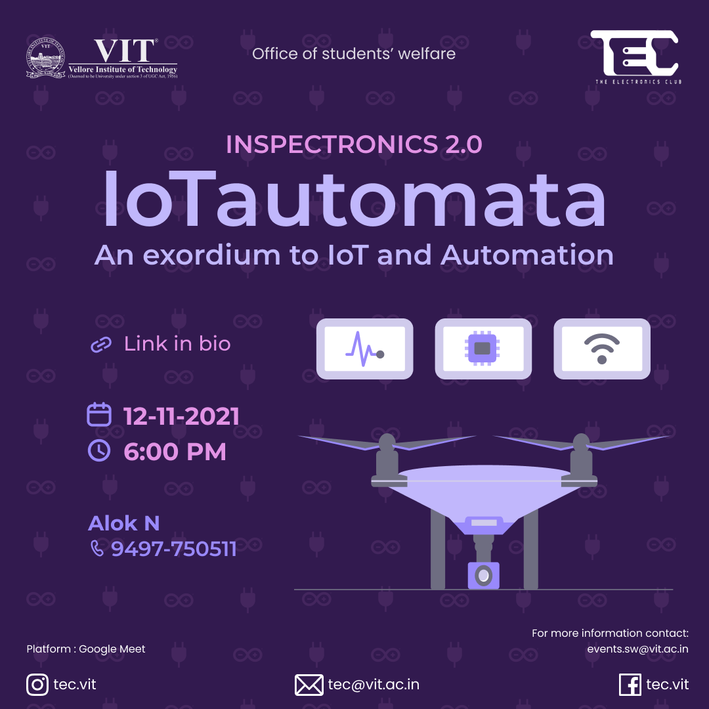
Next event
Ever wondered if you could control the lights at home with a phone? If your car indicators could turn on and off automatically on the road? Life would become so much easier if your refrigerator could tell you that you were running short on groceries! But how? IoT is the answer to all your questions. The revolutionary concept of the Internet of Things refers to a vast network of common devices connected to each-other, actively passing information to and fro, and helping automate tedious processes. At IoTautomata, a hands-on introductory session to the world of IoT, you will learn the fundamentals of building an IoT system and gain valuable experience of working with beginner-friendly IoT tools such as Node-RED. Join us at 6:00 PM on November 12th to know more about IoT and Automation at https://lnkd.in/dp6Dp58n Register now on VTOP! Stay tuned!

Slide 41





Do fill the attendance and feedback form
Follow us on all our socials
tec.vit
github.com/TEC-VIT
the-electronics-club-vit
tec.vit
tec-vit.medium.com

